Slide 1

Now That You Are a Data Scientist, What Next?
An Analytical Summary for the job of a Data Scientist by average salary, job title, skills required, and industry/sector .
An Industry report compiled by:
<L><A><J>
(Lien Lai, Abi Akinlotan, Jennifer Carden)

Slide 2
Who is a Data Scientist?
O’Neil, C., and Schutt, R. Doing Data Science
“More generally, a data scientist is someone who knows how to extract meaning from and interpret data, which requires both tools and methods from statistics and machine learning, as well as being human. She spends a lot of time in the process of collecting, cleaning, and munging data, because data is never clean.”
Shashi Upadhyay, CEO of Lattice
“Data Scientists are referred to as ‘UNICORNS’. They are professionals with a diverse skillset that is not commonly found in a single individual”

Slide 3


Jennifer Carden
Married with three kids.
All girls! Ages 8 (twins) and 17 months.
From Panama City FL but moved to Fargo ND last year.
I love a challenge and strive to apply 110% in everything I do.

Slide 4


Lien Lai
Married with three kids.
All Girls! Oldest is 18 yr, middle is 16 yr and youngest is 9 yr.
My sister and niece(who is 10 yr.) live with us.
We do everything together.
I have a BA in Arts
I’ve been working with children for the past 18 years.

Slide 5

Abi Akinlotan
First of 3 sisters, we are close-knitted and very protective of each other.
I have a BSc in Microbiology.
Over the years I have deployed data insights to marketing strategies and building business solutions.
I currently work in the Healthcare Sector but secretly wish I was either coding or growing a startup.

Slide 6
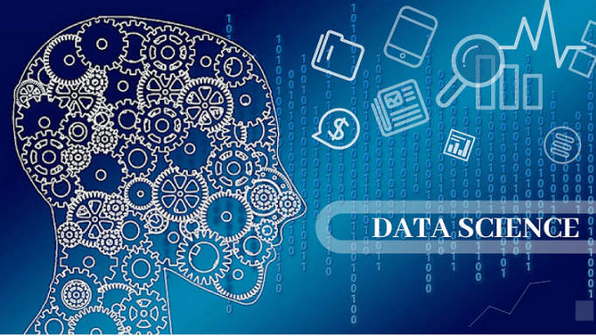
DATA SCIENCISTS’ SALARIES (2021)
This Dataset contains information on ratings, average salaries, necessary skills, sector, location and industry requirements for the position of a Data Scientist.
Library: Kaggle
https://www.kaggle.com/nikhilbhathi/data-scientist-salary-us-glassdoor?select=data_cleaned_2021.csv

Slide 7
What Does a Data Scientist/Analyst Do?
> Statistical Analysis and Computing
> Process Large data sets
> Machine Learning
> Deep Learning
> Data Visualization
> Data Wrangling
> Mathematics
> Statistics
> Programming
> Big Data

Slide 8
How Does Being a Data Scientist Make a Difference in our Lives?
By <L><A><J>
(Lien Lai, Abi Akinlotan, Jennifer Carden)

Slide 9
What skills are needed in Data Science?
Technical
Programing
Non-Technical
Strong Business Acumen
Knowledge of SAS and Other Analytical Tools
Adept at Working with Unstructured Data
Good Communication Skills
Great Data Intuition

Slide 10
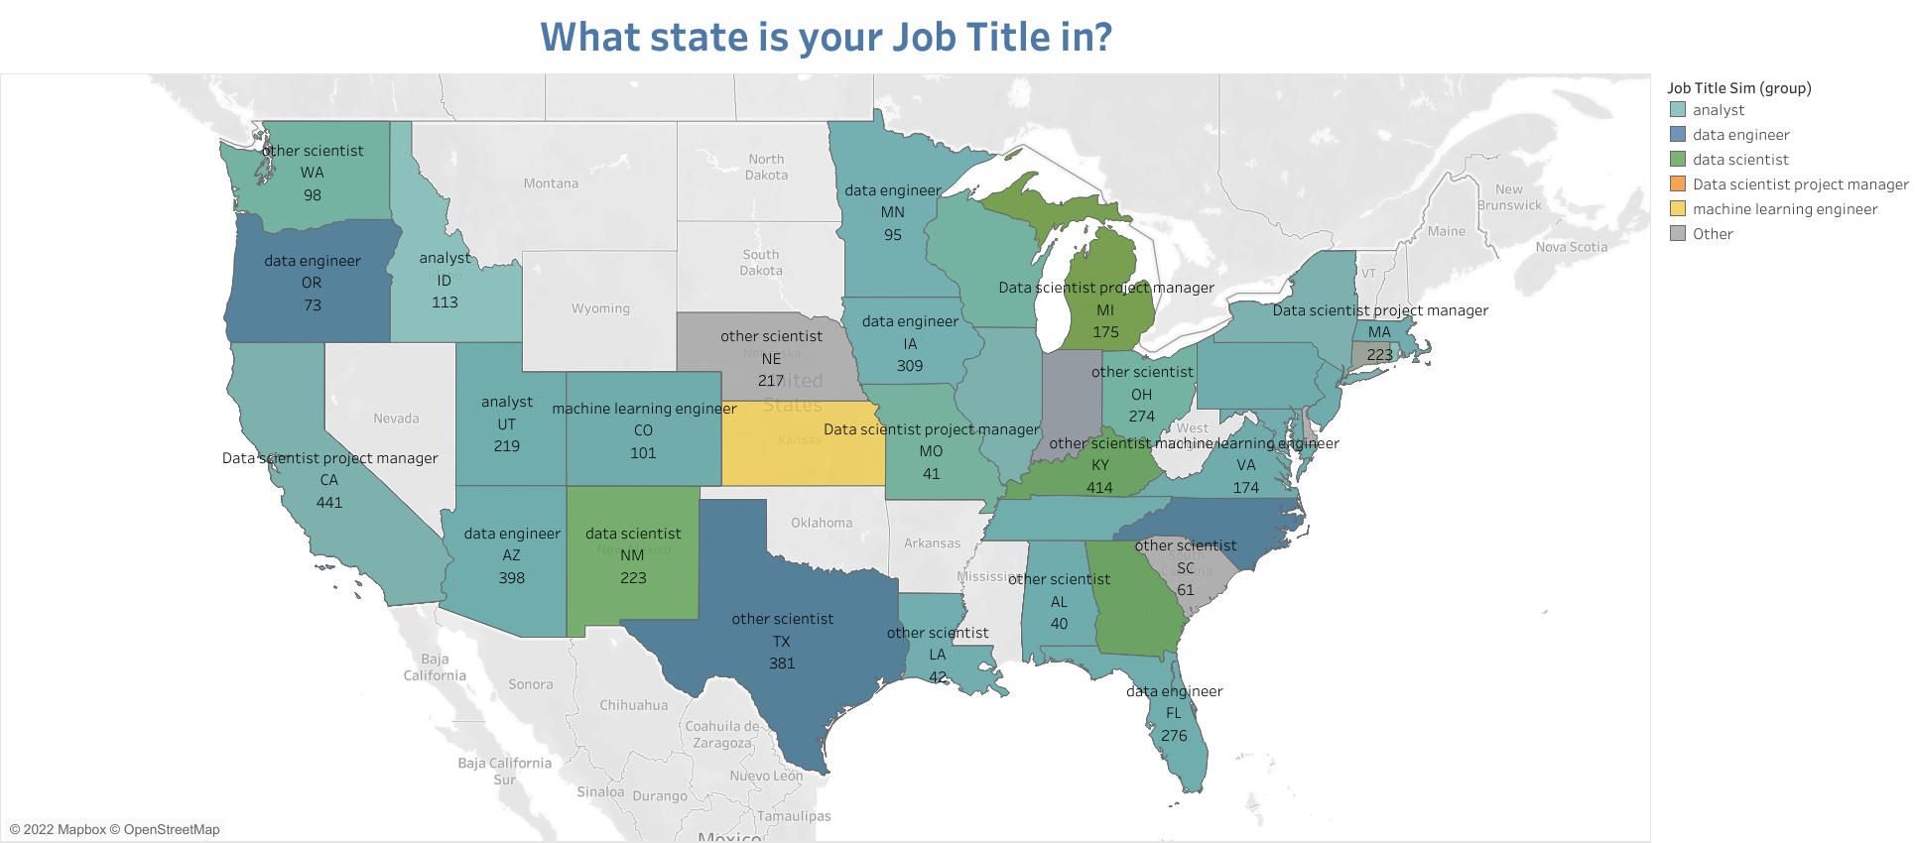
Job title

Slide 11
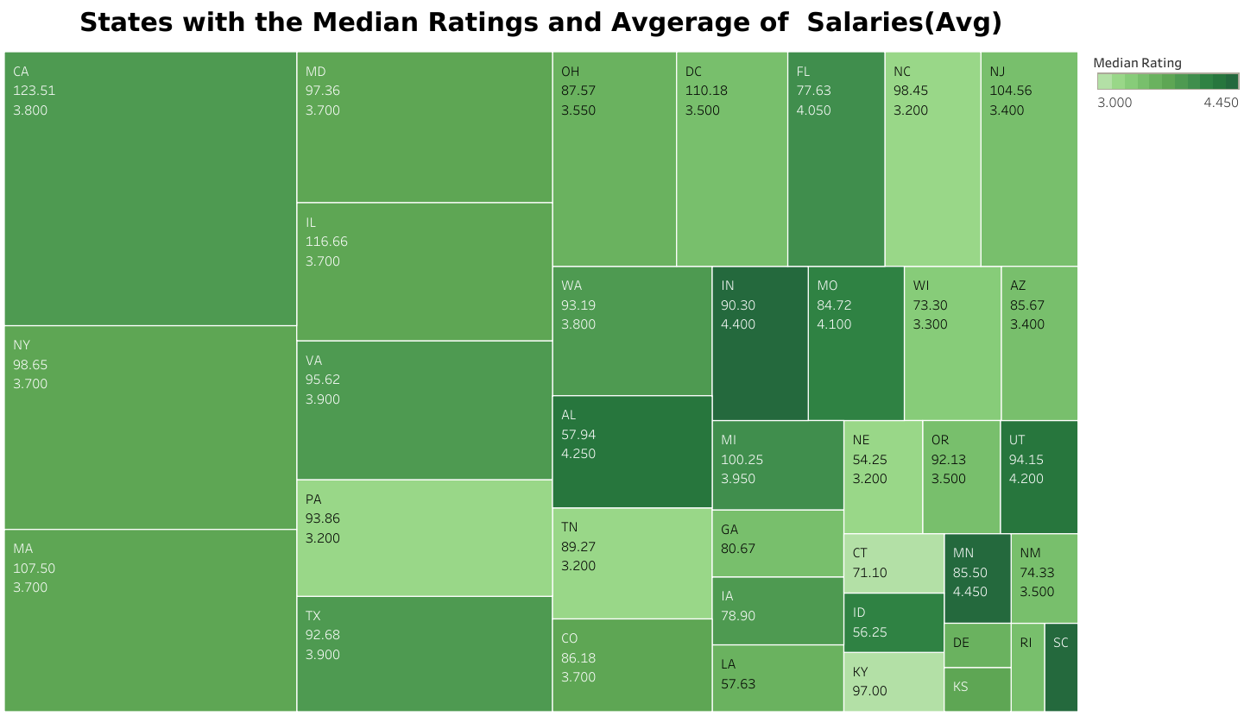
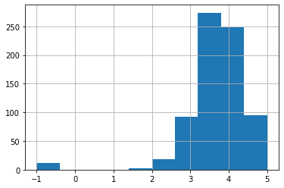
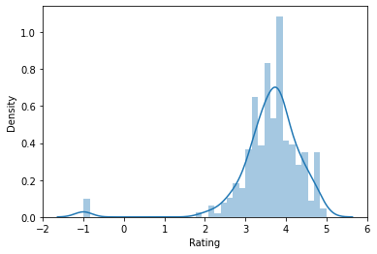
Majority of the companies have a rating between a 3 and 4.

Slide 13
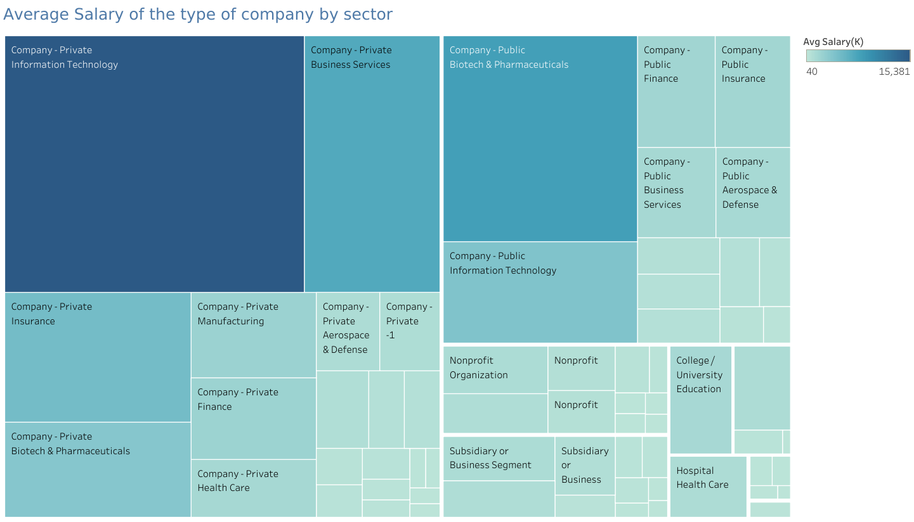
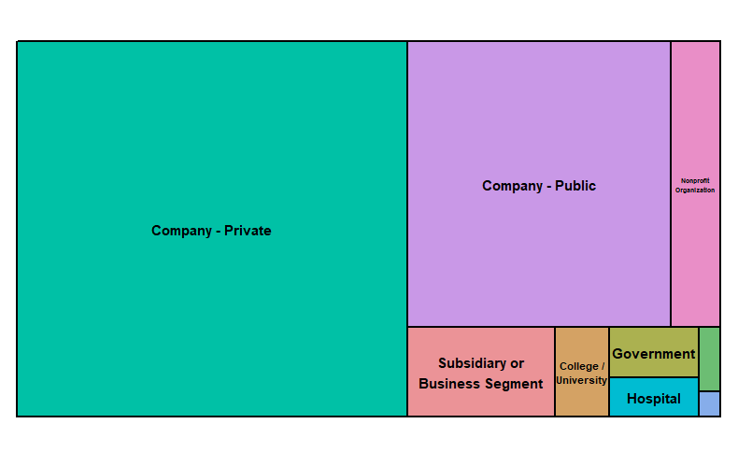
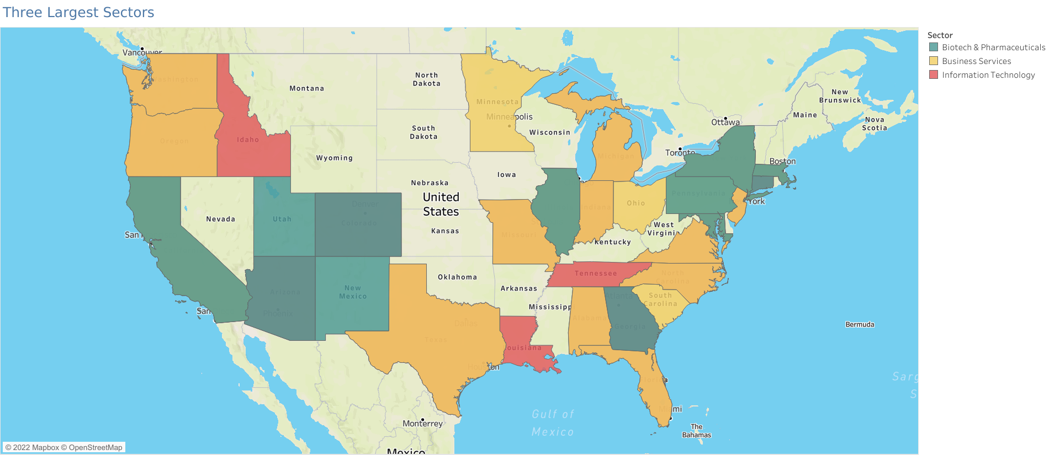
Which type of Company pays the most?
Where are the top three types located?

Slide 14

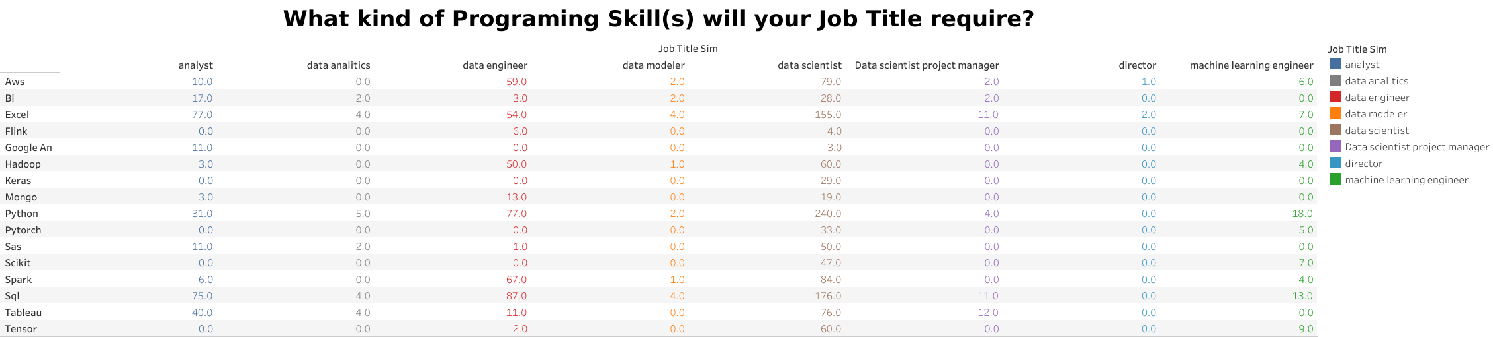
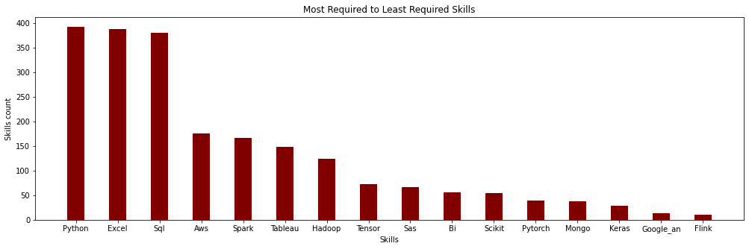

Slide 15

Top 5 companies that had the most counts:
Mass Mutual is an insurance company in Spring Field, Massachusetts. They are deal with life insurance, retirement, college and home budgeting plans.
Reynolds American is a Research Tobacco company in Winston-Salem, NC. They are the subsidy company to the British American Tobacco P.L.S and parent to the products of Newport, Camel, Snus and some others.
Takeda Pharmaceuticals is a Japan owned company that has world wide officed in US, Europe, and Canada. The US company is in Lexington, MA. They focus research on oncology, rare diseases, neuroscience, gastroenterology, plasma-derived Therapy, and vaccines.
Software Engineering Institute is a research and development center sponsored by the US Dept. of Defense in Pittsburg, PA. SEI has delivered innovative methods, tools, algorithms, and frameworks to meet current software and cybersecurity needs and provide a foundation for combating future ones.
PNNL is a research facility in Washington State. PNNL’s core capabilities are organized into five areas:
> 1. Chemical and Materials Sciences,
> 2. Computational and Mathematical Sciences,
> 3. Earth and Biological Sciences,
> 4. Engineering, and
> 5. User Facilities and Advanced Instrumentation.

Slide 16
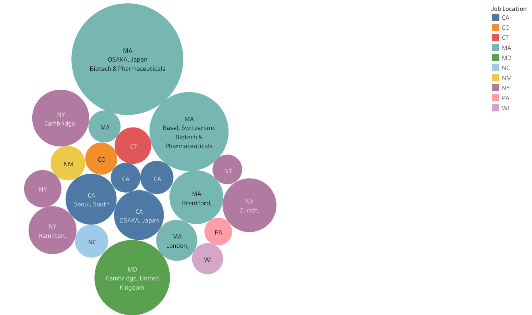
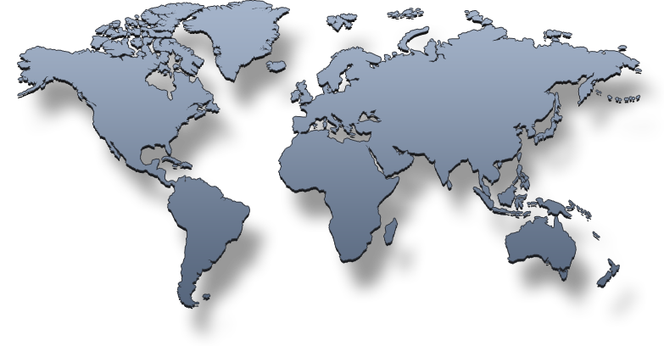
Bubble graph
Not All Companies are in the US

Slide 17
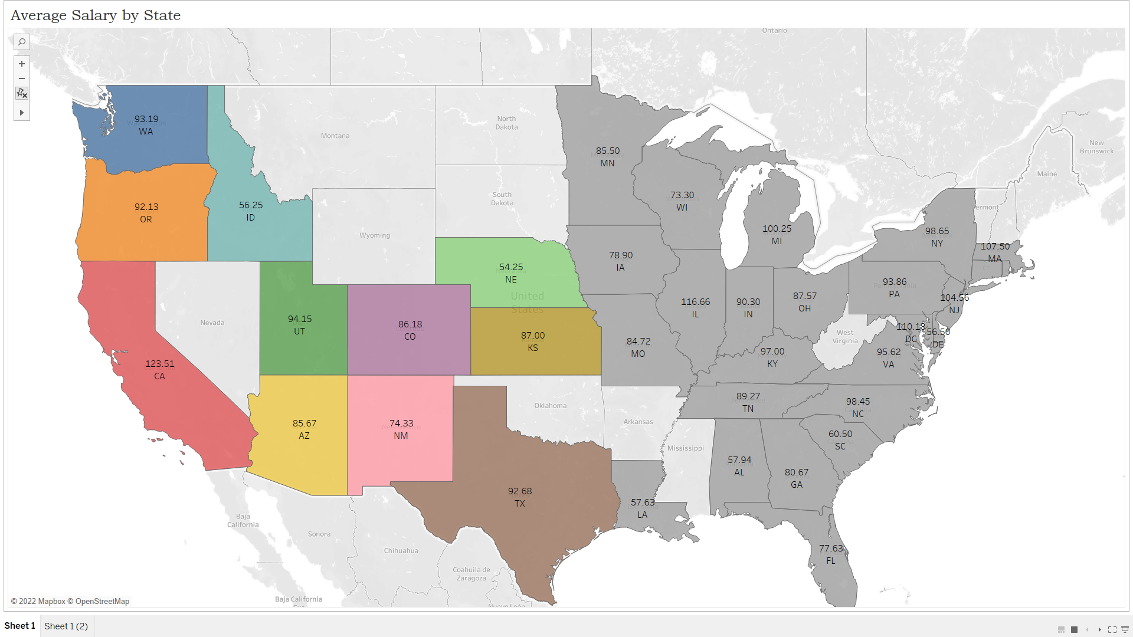
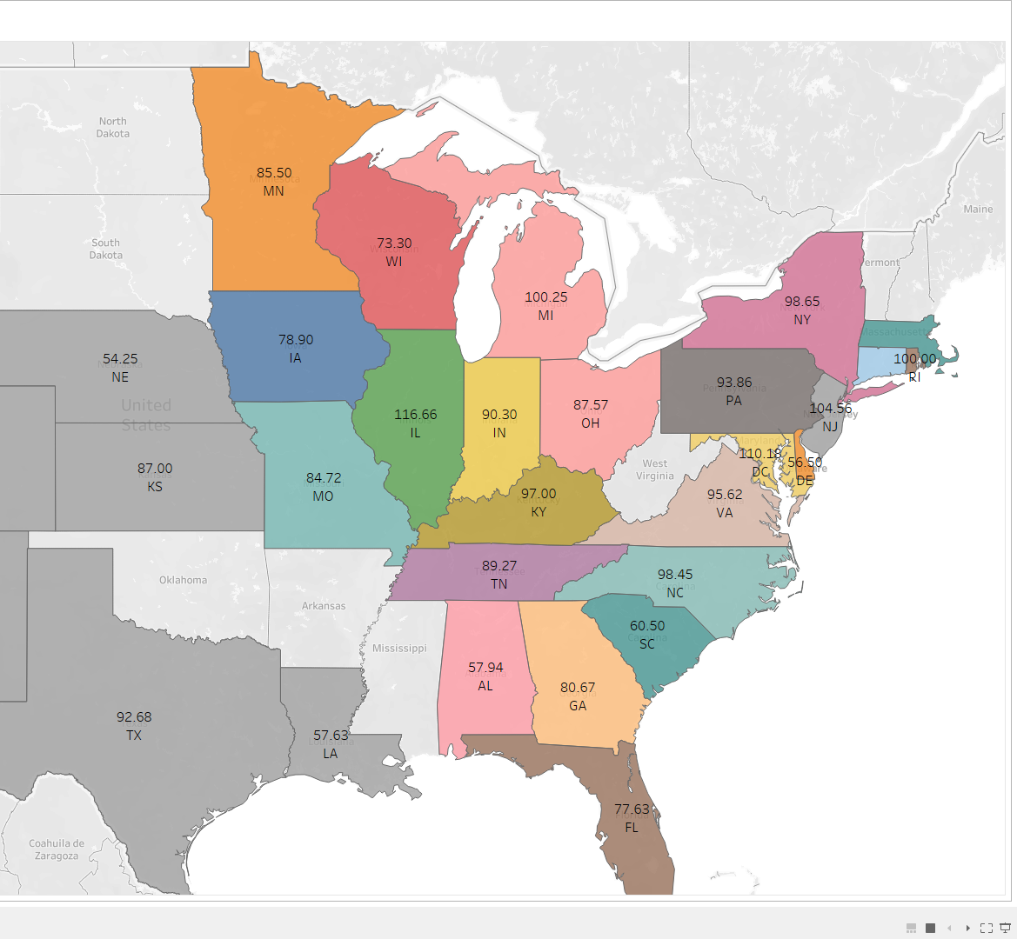
Working on the West Coast Vs. East Coast
West Coast Salaries
East Coast Salaries

Slide 18
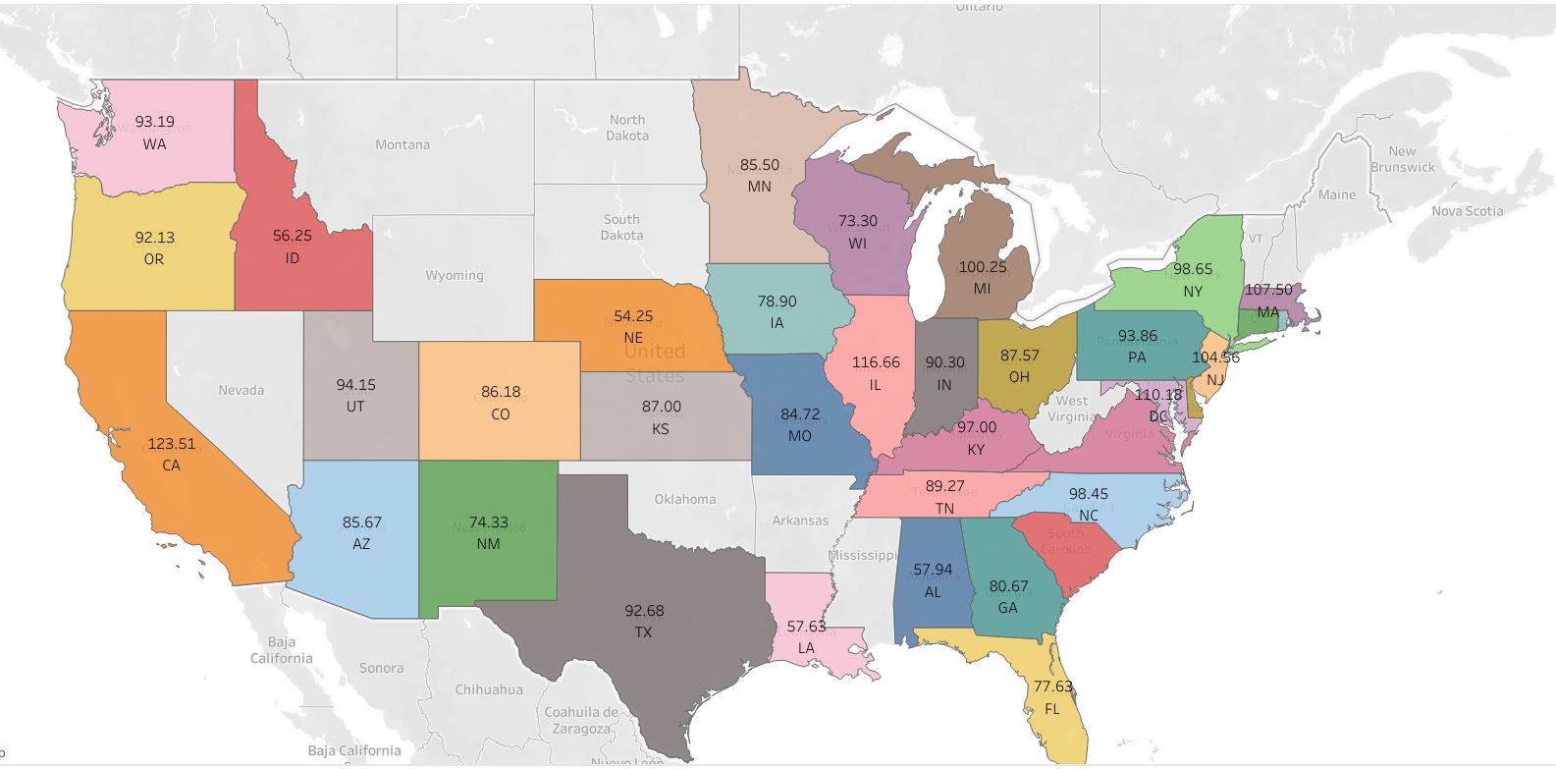
How much could a Data Analyst
make?

Slide 19
